Slide 1
Project: More Closer Look at the Optimization Landscapes of GANs
Presented by Dachao Lin

Slide 2

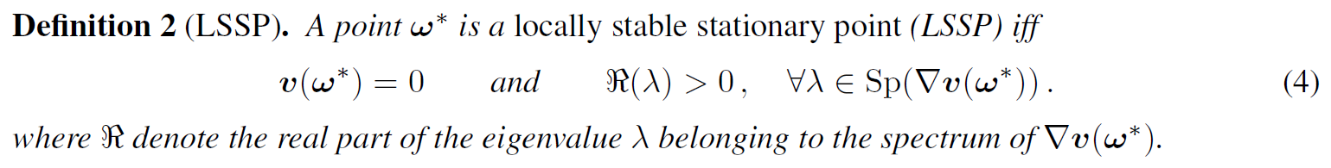
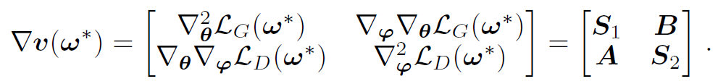
Recap1: LNE and LSSP
Local Nash equilibrium (LNE), i.e. a point only locally true.

Slide 3
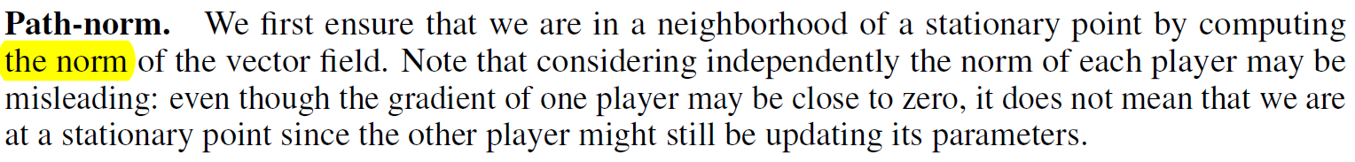
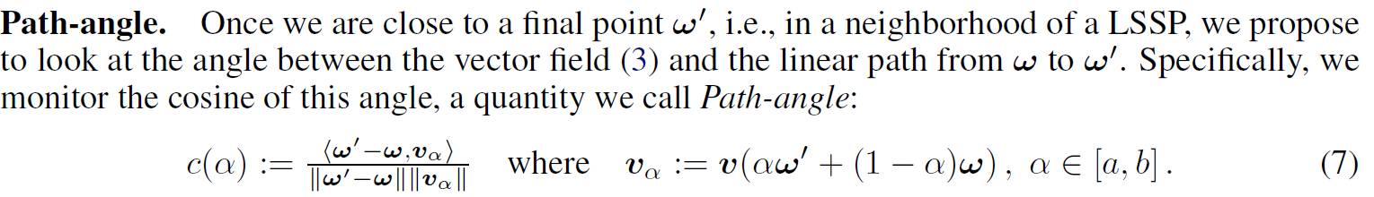

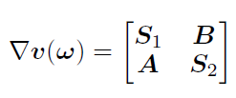
Recap2: Path-norm Path-angle

Slide 4
Motivation
Path-norm and Path-angle with initial value and training epoch isn't enough to see the whole landscape of GANs.
Check some other methods which are able to handle strong rotational components during training.
The derivation in LSSP utilizes approximation in the game vector field, particularly around one LNE point. However, due to high-convexity of neural networks, the rotation center may not be unique, which can be seen through Path-angle.

Slide 5
Schemes
Get Path-norm and Path-angle in the last few training epochs.
Average of final few models parameters’ performance.
Verify LSSP changes during training epochs.

Slide 6
Experiments Setting
Loss: NSGAN, LSGAN, WGAN, WGAN-GP
Datasets: MoG, MNIST
Networks:
MoG: generator and discriminator are one hidden layer with ReLU activations fully connected NN.
MNIST: Generator: three convolutional layers with BN. Discriminator: two convolutional layer and one fully-connected layer.
Optimization methods: Adam
Method: Path-angle and Path-norm

Slide 7
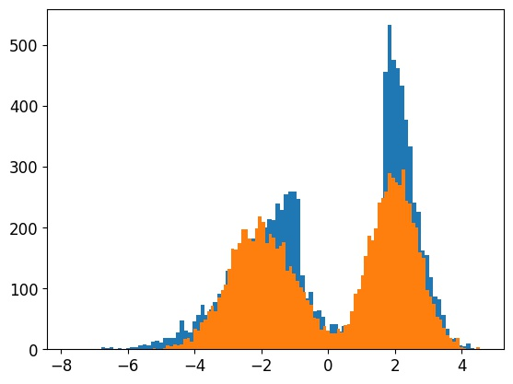
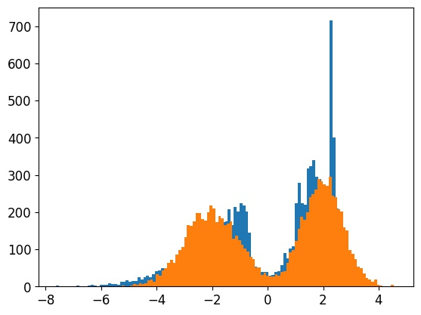
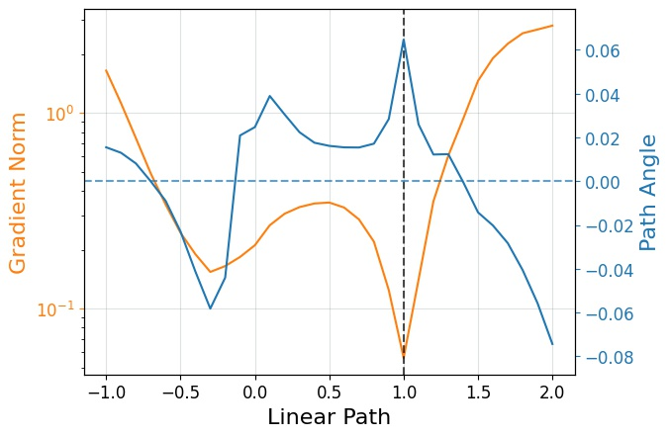
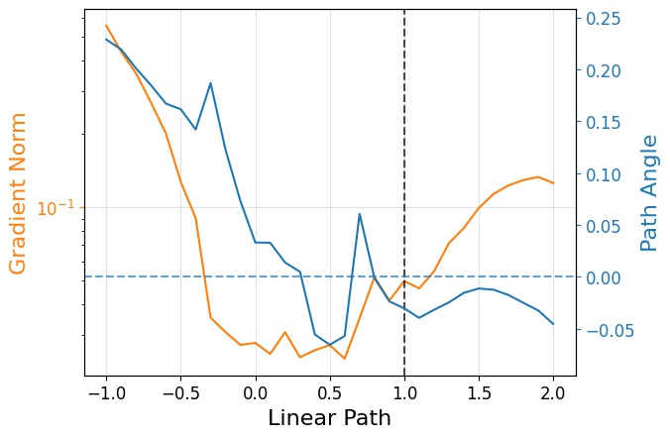
Interpolation from initial value fails to tell LNE information (Gaussian NSGAN)
Epoch 20000
Epoch 30000
Initial and final epoch params
long distance
irrelative direction
Final few epochs params
near LSSP
Initial and epoch 30000
Epoch 20000 and 30000

Slide 8
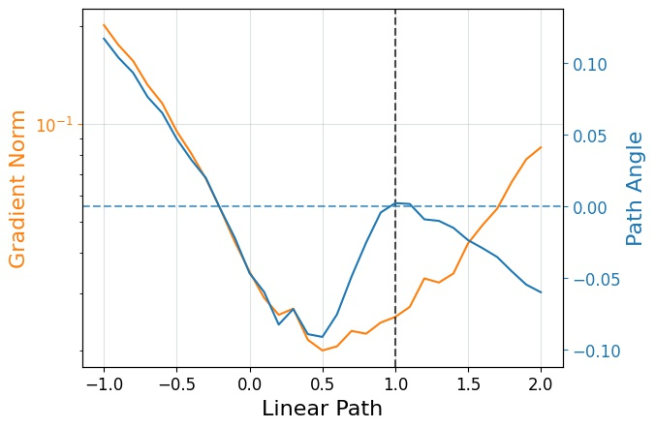
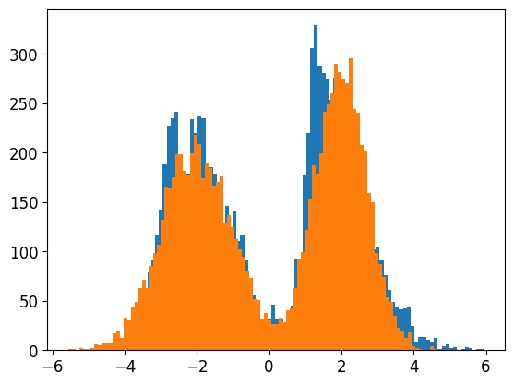
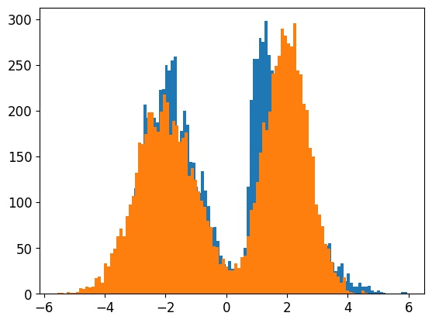
Average of final epochs gives better performance (Gaussian LSGAN)
Epoch 30000
Epoch 50000
Epoch 30000 and 50000
Average model gets less gradient norm
No rotation component of average model (LSSP?)

Slide 9
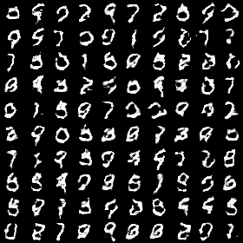
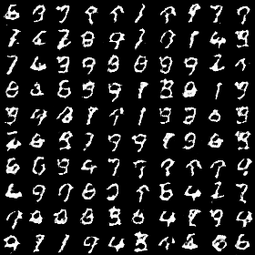
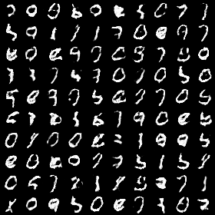
Rotation of GAN is more complicated than LSSP (MNIST)
NSGAN
WGAN
WGAN-GP
Generator: DeConv2d BN DeConv2d BN DeConv2d params: 3163
Discriminator Conv2d Conv2d BN FC params: 1577

Slide 10
Rotation of GAN is more complicated than LSSP (MNIST)
Small step size
Close to a LSSP
Actually plot
The first approximation can be weaken by small step size.
The second approximation need close to a LSSP, so this may not be true if the rotation is behind several LNE points.
The third approxmition can be reduced by multi-plot of jacobian of game field vector in different training epochs.

Slide 11
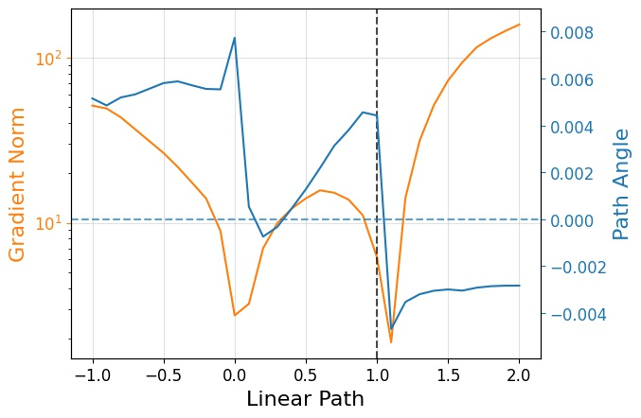
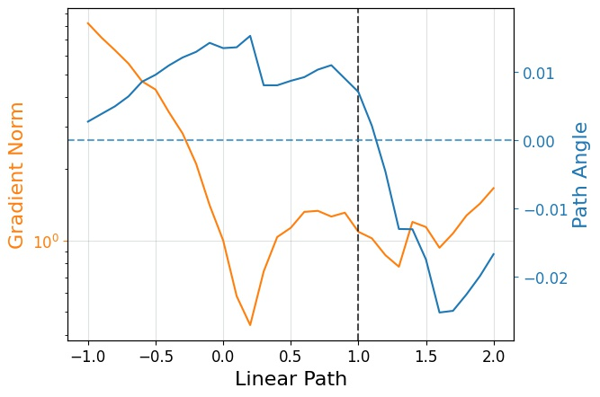
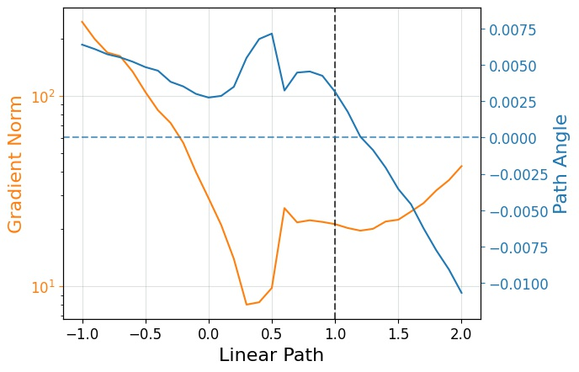
Rotation of GAN is more complicated than LSSP (MNIST)
NSGAN
WGAN
WGAN-GP
Different local minimal (LSSP)
Clear rotation component in different LSSP

Slide 12
Summary
Plot Path-norm and Path-angle in last few epochs is more efficient to see the landscape of GANs.
Using Path-norm and Path-angle can check other methods for handling strong rotational components in GANs optimization.
Rotation center may not be unique. We may focus more on get a solution with great performance rather than a specific LNE or LSSP.

Slide 13
T h a n k s !

